Slide 1
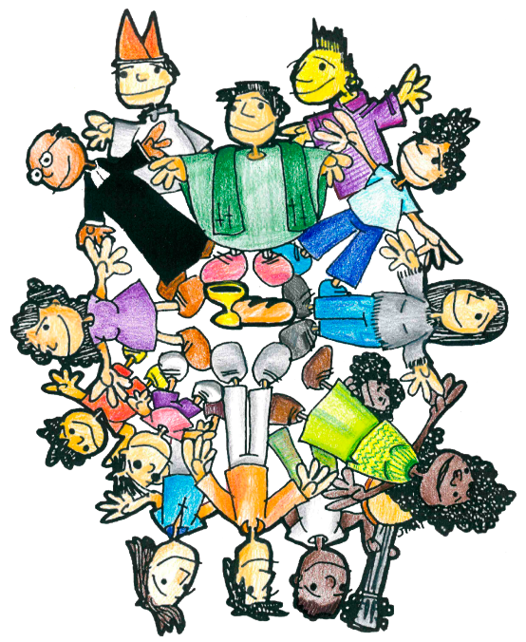
virtues
12
to be a good
Brother
in the context of Association

Slide 2
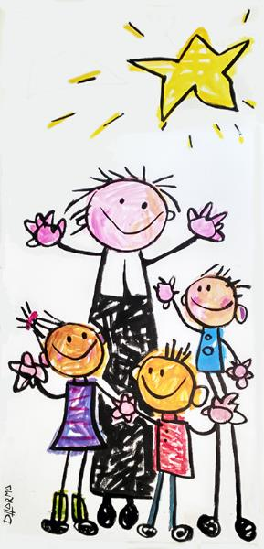
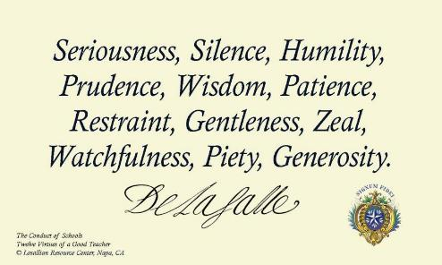
Saint John Baptist de La Salle designated 12 virtues to be a good teacher (they appear in 1711, in the Collection and in 1720 in the Conduite des Écoles)
Gravité
Silence
Humility
Prudence
Sagesse
Patience
Mesure
Douceur
Zéle
Vigilance
Pieté
Generosité
Notes:
Collection, 5
Conduite 19, 1, 1

Slide 3
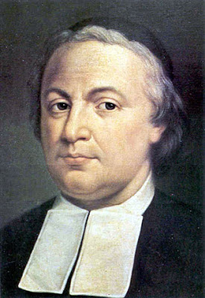
- In 1798 these same virtues were explained and developed by Brother Agathon
(1731-1798)

Slide 4
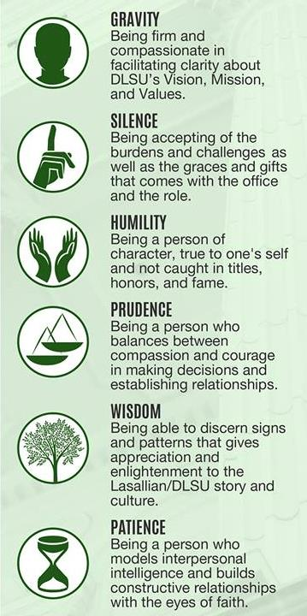
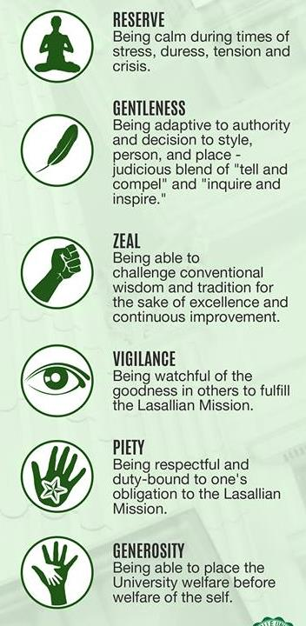

Slide 5
One small question before we continue:
How many times do you think the word virtue/virtues appears in the Founder's writings?
Less than 50 times
About 200 times
About 400 times
More than 700 times
Click on the answer you think is correct.

Slide 6
Saint John Baptist de La Salle also designated and explained 12 virtues that the Brothers should practice (in 1711, in the Collection, CT 15)
Faith
Obedience
Faithful Observance of the Rule
Mortification of the mind
Mortification of the senses
Penance
Profession of penitent
Humility
Modesty
Poverty
Patience
Temperance
We also find a definition of virtue in his writings:
“We call virtues the holy actions, sentiments, dispositions, and affections
contrary to vices and sins.”
EM p. 117
“Q. What is a virtue?
A. A virtue is an inclination to and a facility for doing good.”
DC Part 1, Treatise 2, Lesson 17.

Slide 7
Definition of virtue
(From Latin, virtus. Before Latin vir -force-). A constant disposition that leads to doing good and avoiding evil. Synonym for good habit.
It is the opposite of "vice" or "defect". Another antonym would be “become devalued": that it has lost value, strength or capacity.
"You are the salt of the earth; but if salt has lost its taste,
how shall its taste be restored?
It is no longer good for anything except to be thrown out
and trodden under foot by men.
You are the light of the world. A city set on a hill cannot be hid.
Nor do men light a lamp and put it under a bushel,
but on a stand, and it gives light to all in the house.
Let your light so shine before men,
that they may see your good works
and give glory to your Father who is in heaven." (Mt 5:13-16)

Slide 8
virtues
10
+2
to be a good
Brother
in the context of Association
Notes:
In this presentation we suggest 10 new virtues to be a good Brother, and invite you to complete them with 2 more, the ones that you think are most needed in your reality.

Slide 9
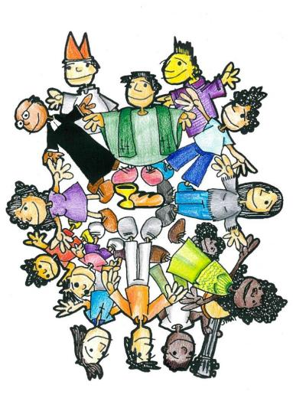
1
- Be prophetic with the poor
11
-
2
- Be accompanied and accompany
12
-
3
- Totally human quality
4
- Creative Fidelity
5
- Teamworking capacity
6
- Living and sharing spirituality
7
- Humble coherence
8
- Opting for Association
9
- Fraternal and inclusive
10
- Promotes faith-culture dialogue
Notes:
Click on each number so that the virtue appears.

Slide 10
1
- Be prophetic with the poor
11
-
2
- Be accompanied and accompany
12
-
3
- Totally human quality
4
- Creative Fidelity
5
- Teamworking capacity
6
- Living and sharing spirituality
7
- Humble coherence
8
- Opting for Association
9
- Fraternal and inclusive
10
- Promotes faith-culture dialogue
Notes:
Click on each number so that the virtue appears.

Slide 11
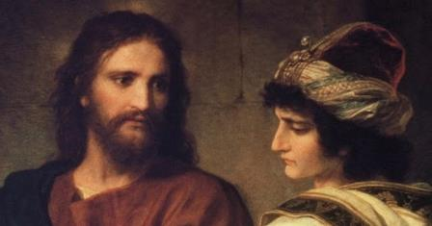
1. Be PROPHETIC with the POOR
To find direct work with the poor.
To search with passion for those who are discarded.
To listen and pray to detect new needs.
To create new options for the poor.
To practice a willingness to surrender to God’s will…
Examples
Counter examples
He leaves his own comfort zone to risk being in a project with the needy.
He learns from the poor. He sensitizes his students to the plight of the poor.
He networks with those who work for the poor.
He's a volunteer at some NGO.
His community welcomes people in need…
He does not understand the needs of vulnerable students, and therefore he does not get involved with them.
He needs to be comfortable
He looks for the positions of power.
He is worried about his own career.
He forgets the social dimensión…
Notes:
Mc 10, 17-30. The rich young man. Leave the riches.
Click on the blue arrow to return to the list of virtues.

Slide 12
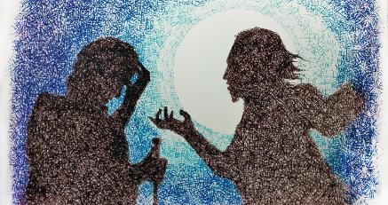
2. Be ACCOMPANIED and ACCOMPANY
To open to continue growth and maturity.
To be accompanied in all facets of his life.
To seek to renew his own vocation: He is on a continuous pilgrimage.
To know how to listen to the lives of others.
To be ready to accompany other people…
Examples
Counter examples
He has been trained about accompaniment.
He renews his own Personal Annual Program.
He gives people time; he is available.
He helps to train other Lasallians and supports and encourages them in these endeavors.
He is converted and he feels closer to God because he is helping others.
He is involved in their ongoing formation.…
He is an individualist in decision making.
He fears being vulnerable.
He is a moral-religious perfectionist.
He lacks intimacy.
He is isolated.
He rejects help…
Notes:
John 3:1-13. Nicodemus, reborn of the spirit.

Slide 13
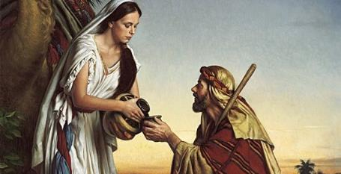
3. TOTALLY HUMAN QUALITY
Capacity for:
- Talking about one's life, one's experiences,
- Expressing emotions, emotional intelligence,
- Communicating empathy, acceptance...
- Speaking clearly and honestly,
- Flexibility in relationships…
Examples
Counter examples
He participates openly in community meetings.
He initiates relationships.
He communicates feelings in prayer.
He recognizes one's own talents.
He talks about his own shortcomings or limitations.
He is passionate about the mission…
He avoids social interaction.
He is locked into the rational.
He follows the monastic model.
He finds the community as a refuge from the world.
He is always in his room…
Notes:
Jn 4. The Samaritan woman at the well. Jesus' welcomes a woman, and a Samaritan woman.

Slide 14
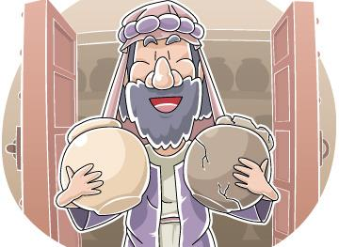
4. CREATIVE FIDELITY
To innovative apostolic initiatives.
To returns to the roots of the charism in order to go beyond the current status.
To find new places, new opportunities to be present as Brothers.
To have visions, dreams.
To be a pilgrim…
Examples
Counter examples
He knows how to pick the most authentic things from the past.
He can meet new needs and still respect the tradition.
He renews, reforms, refounds with prophetic vision.
The moments of crisis stimulate him…
He is concerned only with preserving the inheritance received.
He is just a pilgrim to the past.
Comfortable with mere repetition.
He takes over the mission.
He is suspicious and inhibits changes.
He feels incompetent...
Notes:
Matthew 13:52, "Then Jesus added, 'When a teacher of the law is instructed about the kingdom of heaven, he is like a householder who brings out of his store something new and something old.

Slide 15
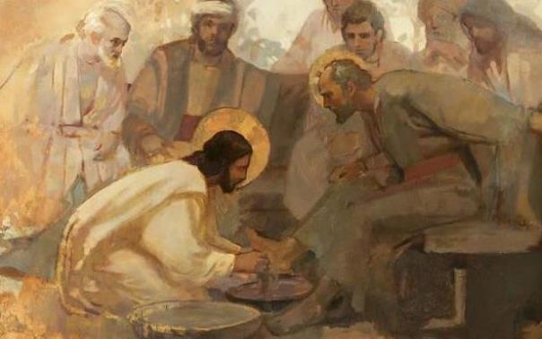
5. TEAMWORKING CAPACITY
To be able to lead collaborative projects.
To be able to delegate and respect subsidiarity.
To seek cooperation and be collegial in all projects.
To collaborate in projects and initiatives of others.
To work for peace, coexistence and harmony…
Examples
He feels comfortable contributing as one of the group.
He lives his responsibilities as a service.
He exercises authority in an evangelical way.
He is able to put his talents at the service of the group and community.
He doesn't mind being under the authority of a lay person…
Counter examples
He takes sole ownership of the mission.
He has a individualistic approach all times.
He loves the hierarchical model.
He protects his talents.
He downplays the importance of community.
He is impatient…
Notes:
Jn 13, 1-15, wash the feet. Mt 20:20-28, The request of the mother of the Zebedee, that whoever wishes to be first may be last and servant of all.

Slide 16
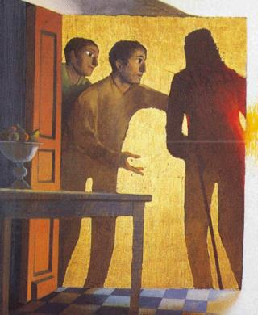
6. LIVING AND SHARING SPIRITUALITY
To have a rich inner life.
To facilitate the spiritual animation of groups.
To prepare creative liturgies.
To express one’s spirituality.
To share Lasallian spirituality in ministry.
To share the mystique of the everyday…
Examples
Counter examples
He takes times to prepare the community prayer.
He shares his spirituality at comunal prayer and community meetings.
He makes up new psalms and prayers.
He remains active in his own theological and biblical formation.
He speaks and accepts his limitations…
He focuses on devotions and rituals only.
He is repetitive and stuck in spiritual expression.
He is a workaholic.
He has a weak spirituality.
He is superficial.
He is derelict in spiritual practices...
Notes:
Lk 24, 13-35. The disciples of Emmaus. They discuss, they invite Jesus to supper, Jesus breaks the bread, they change their intention to flee and they return to Jerusalem.

Slide 17
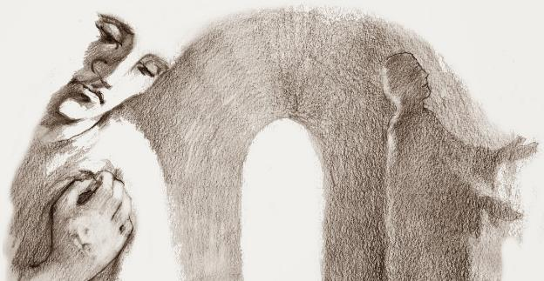
7. HUMBLE COHERENCE
To live his vows of poverty, celibacy and obedience with joy and consistency.
To accept the decrease in numbers, in vitality, in the presence of Religious Life.
To be responsible for his mission and assignments.
To embrace reality and develop resilience…
Examples
Counter examples
He gives witness to his vocation.
Is a sign of the merciful presence.
He listens to other people's lives, he accepts them as they are.
He accepts moments of chaos as
opportunities, as signs of the times…
He acts like he has already solved his life.
He believes that his vocation is first class and the rest second class.
He is narcissistic and selfish.
He doesn't make decisions.
He gets discouraged.
He avoids the hard questions...
Notes:
Lk 18:9-14. The Pharisee and the publican... Who is justified?

Slide 18
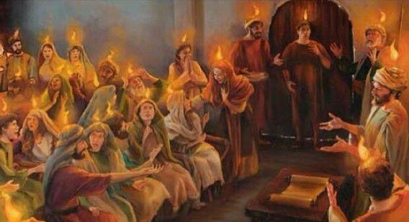
8. OPTING for ASSOCIATION
To believe in a Church communion, community of communities.
To trust in the capacities of the laity.
To recognize the contribution of the lay vocation.
To esteem in his own vocation.
To open to inter-congregationality.
To live Association as the primary vow…
Examples
Counter examples
He is involved in the formation of Lasallians.
He is committed to the needy.
He is ready to accompany others.
He encourages the community to welcome lay people.
He participates in mixed communities.
He encourages a Culture of Vocation, involving all vocations…
He is reticent with Association for fear of:
- losing face.
- being removed from one's status.
- change.
He is embedded in the successes of the past.
He is not able to read the signs of the times.
He only shares "work" with lay Lasallians...
Notes:
Acts 2, 1-13. The Spirit comes upon people of every race, in every tongue.

Slide 19
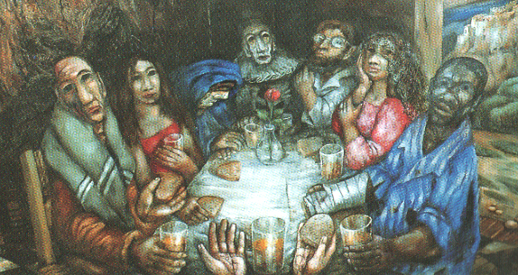
9. FRATERNAL and INCLUSIVE
To believe and identify with community life.
To be proactive in the community.
To be able to combine self-realization and give in to the needs of the community if necessary.
To develop one's own feminine dimension, and sensitivity to Lasallian women…
Examples
Counter examples
He's a member of a mixed community.
He welcomes all kinds of people.
He invites others to participate in community activities.
He knows how to get around socially.
He participates in other intentional faith communities.
He generates ecclesiality…
Their personal needs always take precedence over the needs of the community.
He's looking to keep his privileges.
He feels better in closed and well-structured groups.
He is too focused on work.
He values the patriarchy...
Notes:
Mc 2, 1-17. Lk 14, 15-24. Mt 26:26-29. Jesus' meals with the poor, sinners, disciples. The Last Supper. The breaking of the bread and the wine.

Slide 20
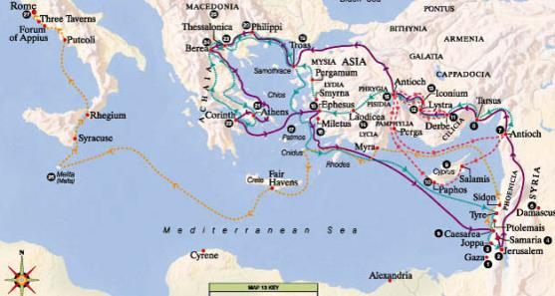
10. PROMOTES FAITH-CULTURE DIALOGUE
To be a seeker, open to question and to give reason for his faith.
To be proactive in culture changes.
To value the world positively and at the same time be critical of current values.
To be proactive in religious education and catechesis.
To have an up-to-date scientific and social background...
Examples
Counter examples
He finds new pastoral methods to communicate the Gospel.
He believes that the Church must evolve and a new Church is possible.
He participates in various forums and groups.
He recognizes a part of the truth in everyone.
He trusts in God's action here and now.
He inculturates the Gospel…
He has fundamentalist attitude.
He thinks he has the answer to all the questions.
He thinks the world has no positive value.
He thinks all dialogue seems to favour relativism.
He fears difference.
He is naive...
Notes:
Acts 13-20. Paul's travels, preaching to the Gentiles, conflict with Judaizing Christians. He opens Christianity to other cultures.

Slide 21
virtues
10
+2
to be a good
Brother
in the context of Association
Notes:
In this presentation we suggest 10 new virtues to be a good Brother, and invite you to complete them with 2 more, the ones that you think are most needed in your reality.

Slide 22
11. New virtue...
Explanation
Examples
Counter examples
Some examples
Some counter-examples
Notes:
Adding text from the Gospel and an image that identify the virtue.

Slide 23
12. New virtue
Explanation
Examples
Counter examples
Some examples
Some counter-examples
Notes:
Adding text from the Gospel and an image that identify the virtue.

Slide 24
Knowing is not enough; we must apply.
Willing is not enough; we must do.
Johann Wolfgang Von Goethe

Slide 25
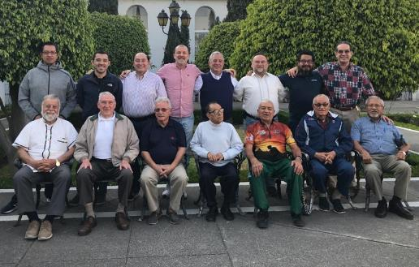
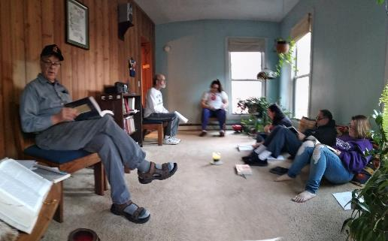
This reflection has been made possible by the contribution of:
Brothers and Lasallians who participated in the ongoing formation for Brothers on Association, Puebla (Antilles-South Mexico District) in February 2020.
The Bedford Park Community of Brothers and Volunteers in New York during the coronavirus crisis in March-April 2020.
Secretaries for Association.
in the context of Association

