Slide 1
The 12 virtues of a good administrator
Notes:
Slide background copyright.
https://poweredtemplate.com/es/plantilla-de-powerpoint-n%C3%BAmeros-blue-8051/

Slide 2
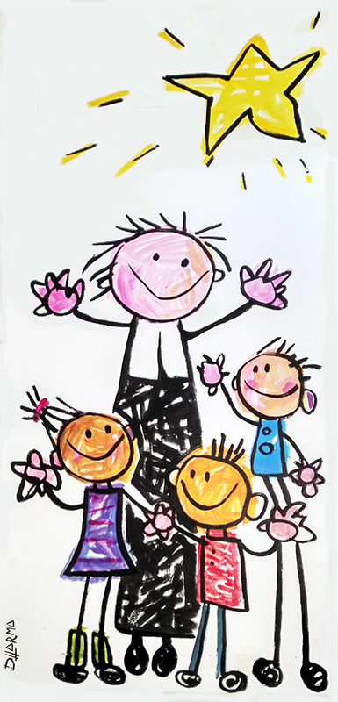
St. John Baptist De La Salle designated 12 virtues to be a good teacher (They appear in 1711, in the Collection of Little Treatises, 5 and in 1720 in the Guide to Schools, 19, 1, 1).
Gravité - Gravity
Silence
Humilité
Prudence
Sagesse - Wisdom
Patience
Mesure - Reserve
Douceur - Gentleness
Zéle - Zeal
Vigilance
Pieté - Piety
Generosité – Generosity

Slide 3
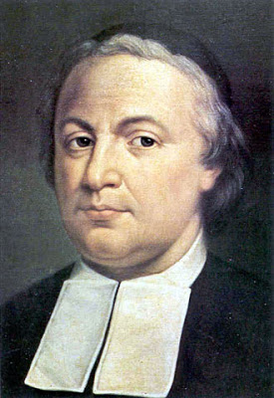
- In 1798 these same virtues were explained and developed by Bro. Agathon (1731-1798).

Slide 4
Definition of virtue
(From Latin, virtus. Before Latin vir -force-). A constant disposition that leads to doing good and avoiding evil. Synonym for good habit.
Opposes "vice" or "defect". Another antonym would be "distorted": that it has lost value, strength or capacity.
"You are like salt for everyone on earth. But if salt no longer
tastes like salt, how can it make food salty? All it is good for
is to be thrown out and walked on.
You are like light for the whole world. A city built on top of
a hill cannot be hidden, and no one would light a lamp and
put it under a clay pot. A lamp is placed on a lampstand,
where it can give light to everyone in the house. Make your
light shine, so that others will see the good that you do and
will praise your Father in heaven.”
Difference virtue-value?
Values are desirable principles (they guide human behavior).
Virtues are values put into practice, in use. Virtues are habits, they are observable.

Slide 5
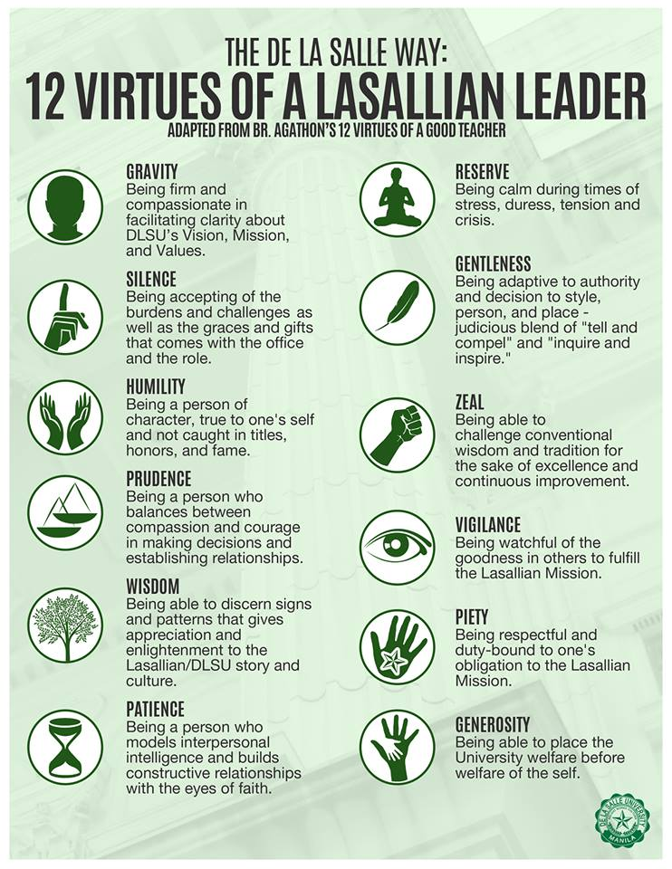
- There have been many translations into other languages and into a more contemporary language:

Slide 6
Also on video (in French) Duration: 6'35''...
Notes:
https://youtu.be/PyKdJ8UPaQA
in case the connection fails.

Slide 7
Brother Pie Nsukula (District Congo), 2018 has worked and developed...
The 12 virtues of a good student:
La discipline,
la docilité,
l’écoute,
le respect,
la ponctualité,
l’honnêteté,
la détermination,
l’application,
l’émulation,
l’entraide,
l’humilité, et
la reconnaissance.
The 12 virtues of good parents
La responsabilité,
la vigilance,
l’écoute,
l’affection,
la fermeté,
la tendresse,
l’abnégation,
l’exemplarité,
la perspicacité,
la patience,
l’humilité, et
la piété.
docility,
listening,
punctuality,
honesty,
application,
emulation,
mutual aid,
humility, and
acknowledgement.
Responsibility
listening
affection,
firmness
tenderness,
self-sacrifice,
exemplarity
insight,
humility, et
piety
Notes:
In italics are marked the virtues that coincide with the 12 virtues of the original good teacher.
"Entraide" in Spanish means: action of helping each other, supporting each other. (Larouse on-line).
"Affection" in Spanish is affection, affection.

Slide 8
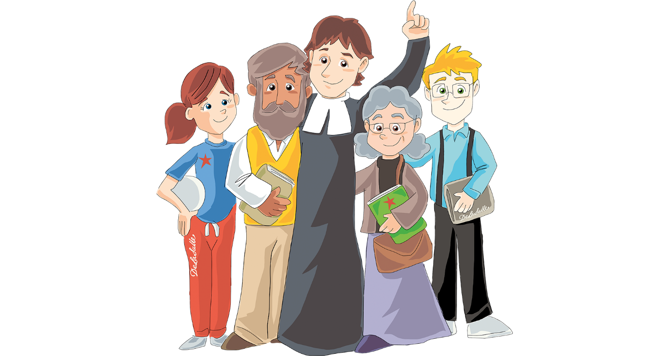
The 12 virtues of a good administrator
Authors:
- Administratives of the Valencia-Palma sector,
ARLEP District.
- Coordination and edition: Br. Paco Chiva.

Slide 9
1.- Responsibility
2.- Empathy
3.- Respect
4.- Patience
5.- Discretion
6.- Resolution
7.- Adaptation
8.- Organization
9.- Service
10.- Humanity
11.- Generosity
12.- Belonging

Slide 10
1.- Responsibility:
Quality of care and attention to what is done or decided.
Ability to respond and commit to one's own decisions.
Exercise the rights and obligations contracted.
Examples and counterexamples:
Submit documentation in due time.
Control the payment of taxes.
Punctuality at work.
Submit incomplete documentation.
Pay a bill in duplicate.

Slide 11
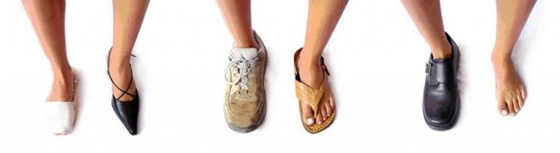
2.- Empathy:
Perceive, share and understand what the other person may feel.
Be able to "walk in someone else's shoes”.
Examples and counterexamples:
Welcome a new teacher who comes for help.
Helping a student in difficulty.
Not realizing that a parent doesn't know how to fill out a form.
Not perceiving the state of mind of peers

Slide 12
3.- Respect:
Consideration and valuation of dignity
of each person.
Care of the environment, of the "common house".
Examples and counterexamples:
Treat people with consideration.
Recycle, save energy...
Be respectful or disrespectful to people because of their appearance, age, sexual or religious orientation...

Slide 13
4.- Patience:
Ability to persevere in the face of difficulties or after a failure.
Maintain a good attitude while we wait.
Examples and counterexamples:
Take care of parents in spite of demanding with bad manners.
Repeat the instructions given in advance without bitterness.
When the software hangs and...

Slide 14
Discretion:
Tactful or good judgement in the way of acting. Caring for words used in compromised circumstances to avoid harm.
Reserving certain information that others should not know.
Do not say more than necessary, to whom it is necessary and when it is necessary.
Examples and counterexamples:
Know what topics you can share with who and who you can't.
Do not take confidential information out of work time.
Disseminate sensitive information.
Criticism without a constructive purpose.
Act without confronting information.

Slide 15
6.- Resolution:
Be diligent in resolving an issue.
Make work easy and simple.
Successfully and quickly manage the solution to a problem.
Examples and counterexamples:
Keep track of your schedule. Be up to date.
Ask for help when work overflows.
Accumulate unresolved issues.
Postpone jobs.

Slide 16
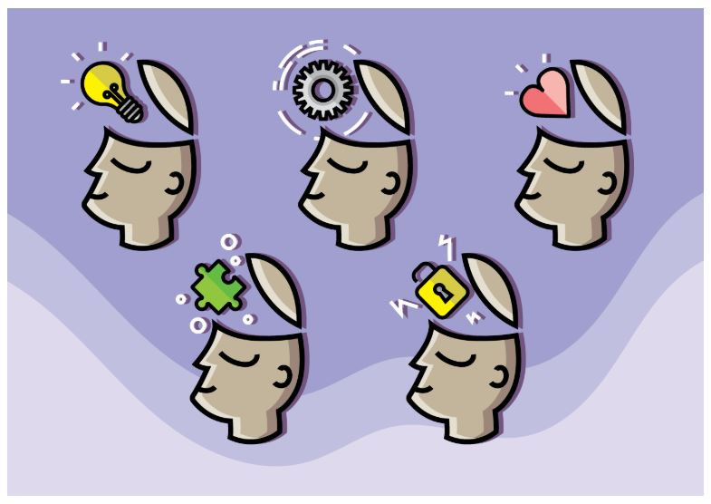
7.- Adaptation:
Ability to learn from reality.
Flexibility to overcome one's own limitations.
Care for personal growth.
Examples and counterexamples:
Willingness to undertake training courses.
Worry about new software: on-line sales, updates.
Avoid new challenges.
Take care only of the professional dimension.

Slide 17
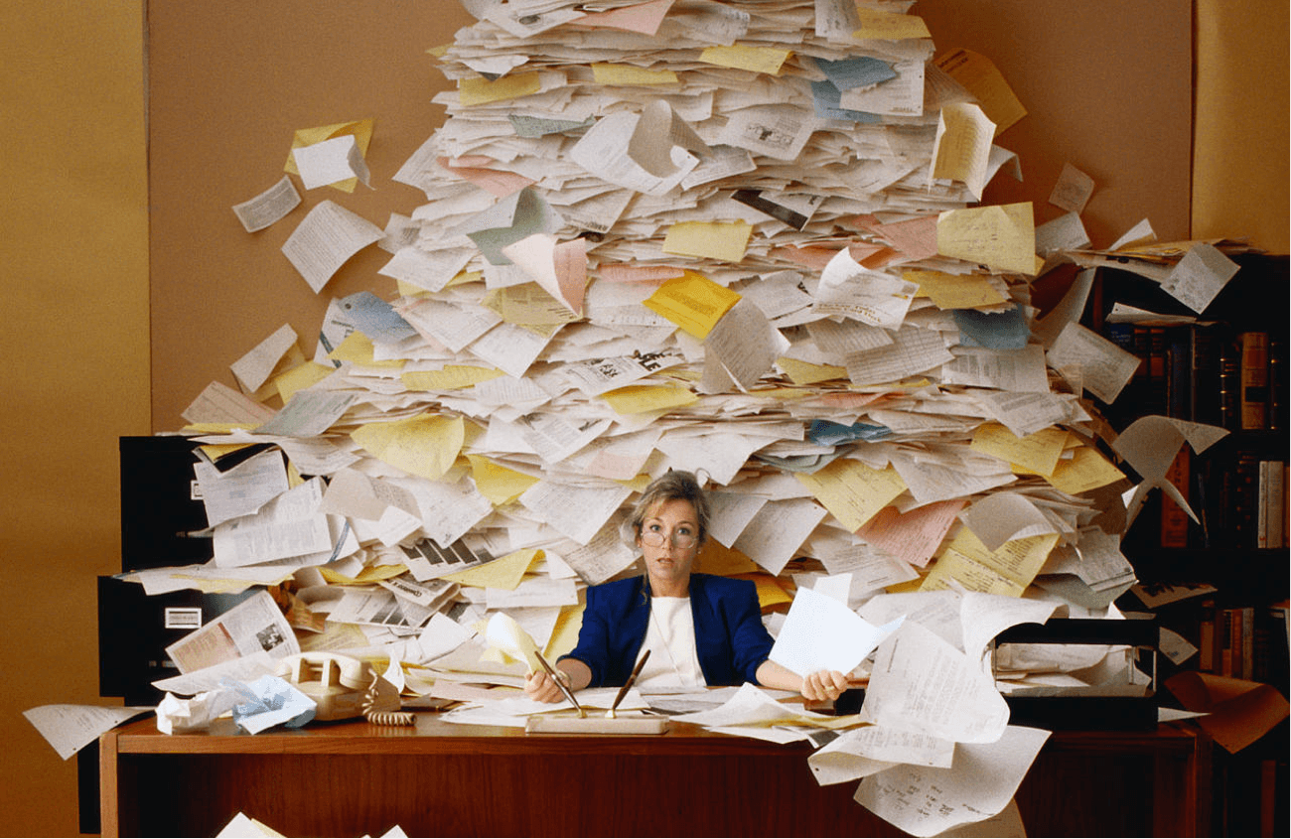
8.- Organization:
Ability to plan work.
Act in a systematic, orderly, disciplined manner.
Examples and counterexamples:
Keep track of documentation.
Good sorting system, cleanliness.
Lack of order in the work center.
Loss of documents.
Forgotten tasks.
No stress management.

Slide 18
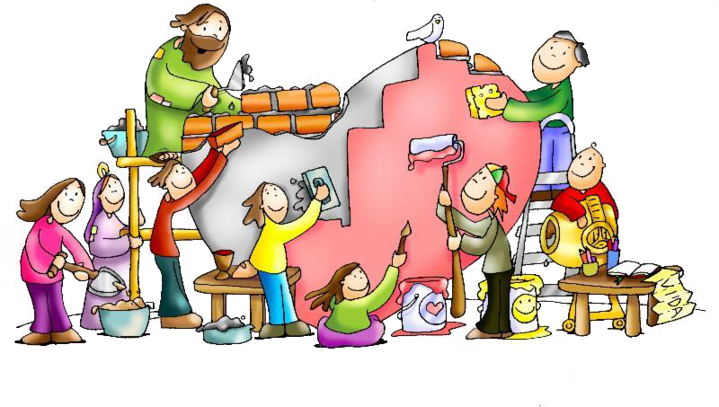
9.- Service:
To develop one's own work with quality.
Ability to feel fulfilled as a person at work.
To live one's work as a mission, as a vocation.
Examples and counterexamples:
Self-evaluate and let oneself be evaluated in the performance of one's own work.
Feeling valued by the rest of the educational community.
Act knowing that the "client" (students, educators, parents...) comes first.
Acting by pure calculation of personal benefits.
Not discovering the transcendent dimension of one's own work.

Slide 19
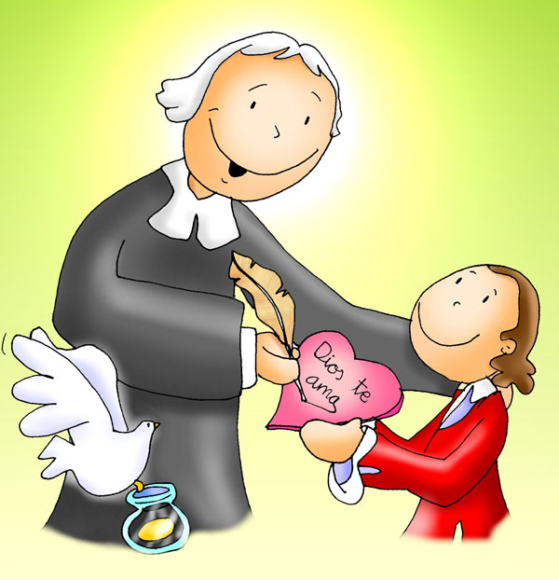
10.- Humanity:
Ability to treat others
with "fatherly firmness and tenderness of mother."
Act as "guardian angel" for those most in need.
Examples and counterexamples:
Take time to listen to people.
Treat everyone with affection, be sociable.
Ensuring a good atmosphere at work.
Look only for yourself.
Ignoring other people's problems.
Hide your own mistakes.
Don't ask for help when you're in need.
Notes:
The expression "fatherly firmness and motherly tenderness" is used by the founder in one of his meditations, MR 101, 3, 2.
The expression "guardian angel" is used by the Founder in MR 198.

Slide 20
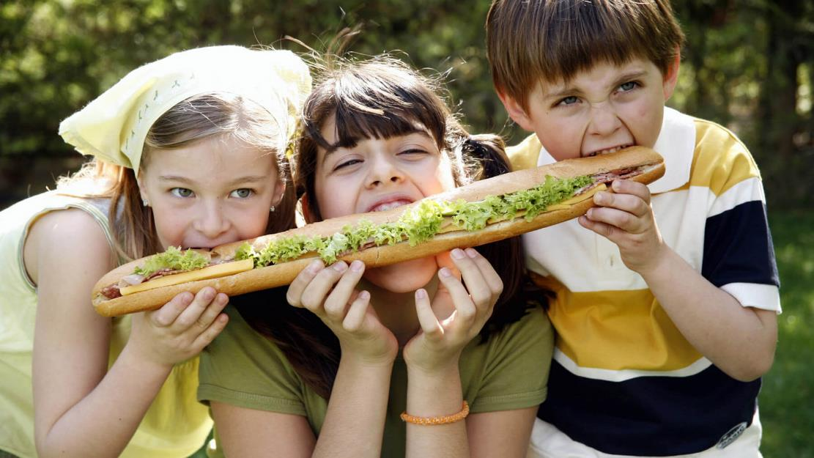
11.- Generosity:
Share with others without expecting anything in return.
Helping, sharing and trying to understand the other, even when doing so takes time away from you to do your own homework.
Perform actions or tasks beyond our functions.
Examples and counterexamples:
Helping to finish a partner's work task.
Offer to collaborate in some pastoral activity.
Have initiatives, be creative.
Seek to have privileges.
To be stingy with one's own talents.

Slide 21
12.- Belonging:
Conscious identification with De La Salle's mission,
Development of the feeling of identification with the rest of the members, whom he understands as equals.
Involvement in school life.
Examples and counterexamples:
To manifest adherence, inclusion, and support for the Lasallian community, including in a public manner.
To represent the community in organizations or entities external to La Salle.
Isolate oneself, inhibit oneself from projects, strategies, and conviviality.
Hold a grudge for mistakes and "wounds" suffered.

Slide 22
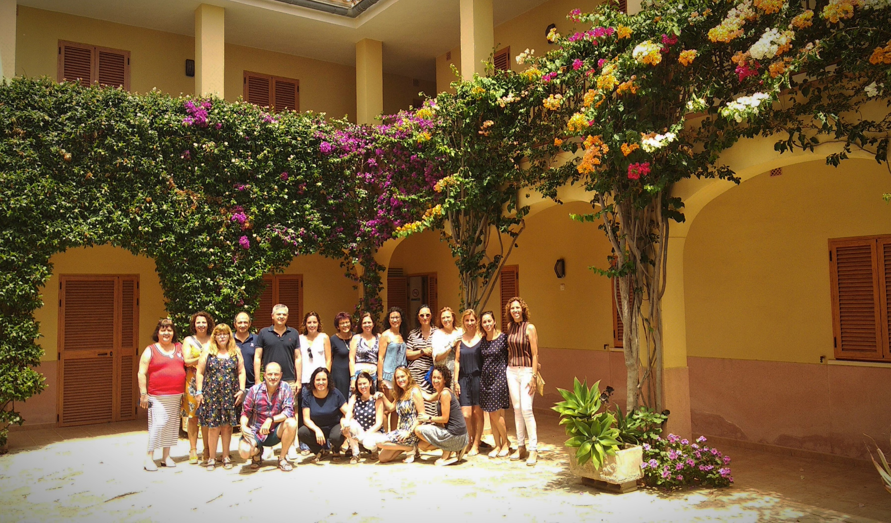
Authors:
Dolores, Olivia, Manoli, José Luis, Br. Paco Chiva, Ernesto, Mª Ángeles, Ángeles, Lucién, Ana, Yolanda, Bárbara, Pili, Mª Carmen, Dami, Cati, Antònia, Laura, Mónica
and Paqui who left before taking the picture.
July 2019

